Slide 1
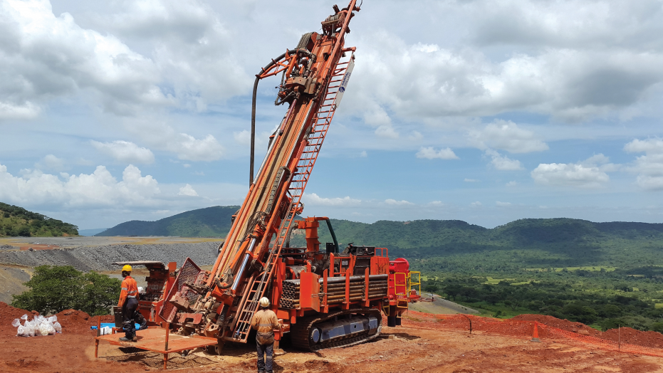
Block Model Estimation Using Machine Learning
Ton Nattapan
Capstone Project

Slide 2
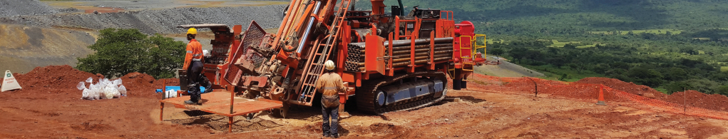
Agenda
Dataset Overview
Business Problem
Exploring Data Analysis
Project Pipeline
Model Evaluation
Conclusion
Block Model
Estimation
Comparison Kriging vs. ML

Slide 3
Dataset Overview
Modified exploration drill hole data and block model estimation using kriging, provided by a consulting company.
Training data: drill hole data
Target: 'Au ppm’
Features: initially 'X', 'Y', 'Z', and later adding 'DomCode' and 'Oxidation’ to enhance predictability

Slide 4
Dataset Overview
First 5 rows of drill hole data
First 5 rows of block model

Slide 5
Business Problem
Background:
Block model estimation using geostatistics can be time-consuming, and results may vary based on the experience and expertise of different geologists.
Problem:
Can machine learning be used in block model estimation?
Objectives:
To accelerate the block model estimation process and reduce human errors.
Stakeholders:
Mine Geologist, Technical Service Manager

Slide 6
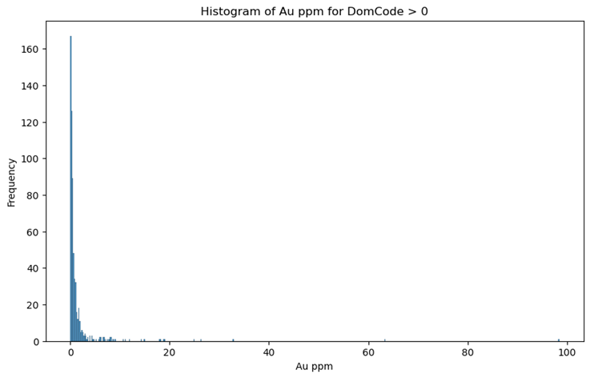
Exploring Data Analysis
Au ppm for DomCode > 0:
Mean: 1.48
Standard deviation: 5.46

Slide 7
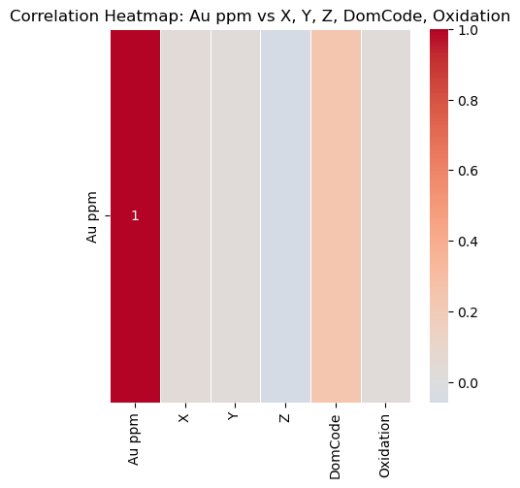
Exploring Data Analysis
Correlations:
Low correlations between 'Au ppm' and the other features
The highest correlation is with 'DomCode', which is 0.24

Slide 8
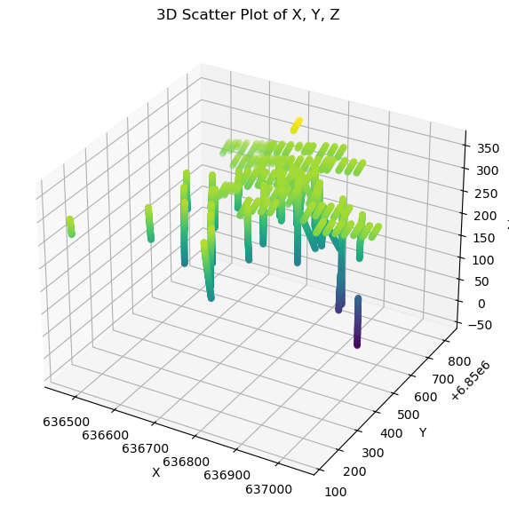
Exploring Data Analysis
Drill hole data in 3D space

Slide 9
Project Pipeline
Data processing
Split data
Model training
Model evaluation
Conclusion
Scale 'X', 'Y', 'Z'
Encoding 'DomCode’, 'Oxidation'
80% training and 20 % testing
Stacking Model
Mean
Can we use ML for block model estimation?
Further work
NN
CNN
Block model estimation
MSE
R-squared
Compare Kriging vs ML
'Au ppm’ prediction
Standard deviation
Distribution
Apply cut of grade

Slide 10
Model Evaluation
Baseline Metrics | Value
Mean Squared Error (MSE) | 0.85
R-squared Score (R²) | 0.00
Choose the stacking model as it has the lowest MSE and the highest R².
Models | Metrics | No DomCode, Oxidation | Included DomCode, Oxidation
Stacking | MSE | 0.80 | 0.72
 | R² | 0.05 | 0.15
Neuron Network | MSE | 0.85 | 0.73
 | R² | 0.00 | 0.13
Convolutional neural network (CNN) | MSE | 0.85 | 0.74
 | R² | 0.00 | 0.12

Slide 11
Block Model Estimation
Five rows of the final block model estimation results using machine learning.
Kriging
ML

Slide 12
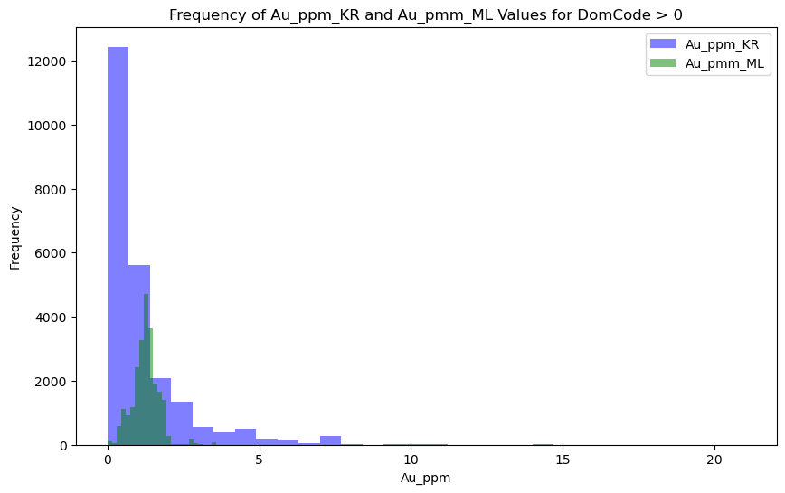
Comparison Kriging vs. Machine Learning
NO CUT-OFF GRADE APPLIED
Machine learning's estimated 'Au ppm' distribution significantly differs from kriging and original drill hole data.

Slide 13
Comparison Kriging vs. Machine Learning
NO CUT-OFF GRADE APPLIED
Metrics | Kriging | Machine Learning
Mean of 'Au ppm' | 1.20 | 1.26
Standard Deviation of 'Au ppm' | 1.45 | 0.44
Sum of 'Au ppm' | 28,455 | 29,815
Without a cut-off grade, machine learning provides a similar mean and sum of 'Au ppm'.

Slide 14
Comparison Kriging vs. Machine Learning
CUT-OFF GRADE OF 0.8 APPLIED
Metrics | Kriging | Machine Learning
Mean of 'Au ppm' | 2.24 | 1.43
Standard Deviation of 'Au ppm' | 1.79 | 0.41
Sum of 'Au ppm' | 20,629 | 13,191
With a cut-off grade of 0.8, machine learning estimates 36% less in the sum of 'Au ppm' due to differences in its distribution compared to kriging.

Slide 15
Conclusion
Can machine learning be used in block model estimation?
Not suitable for narrow vein deposits unless significant improvement in MSE and R-squared. While the estimation provides a similar mean and total amount of metal compared to kriging, the grade distribution is significantly different.
Further development
Explore if machine learning can effectively predict grade of non-vein deposits such as banded iron formations.

Slide 16
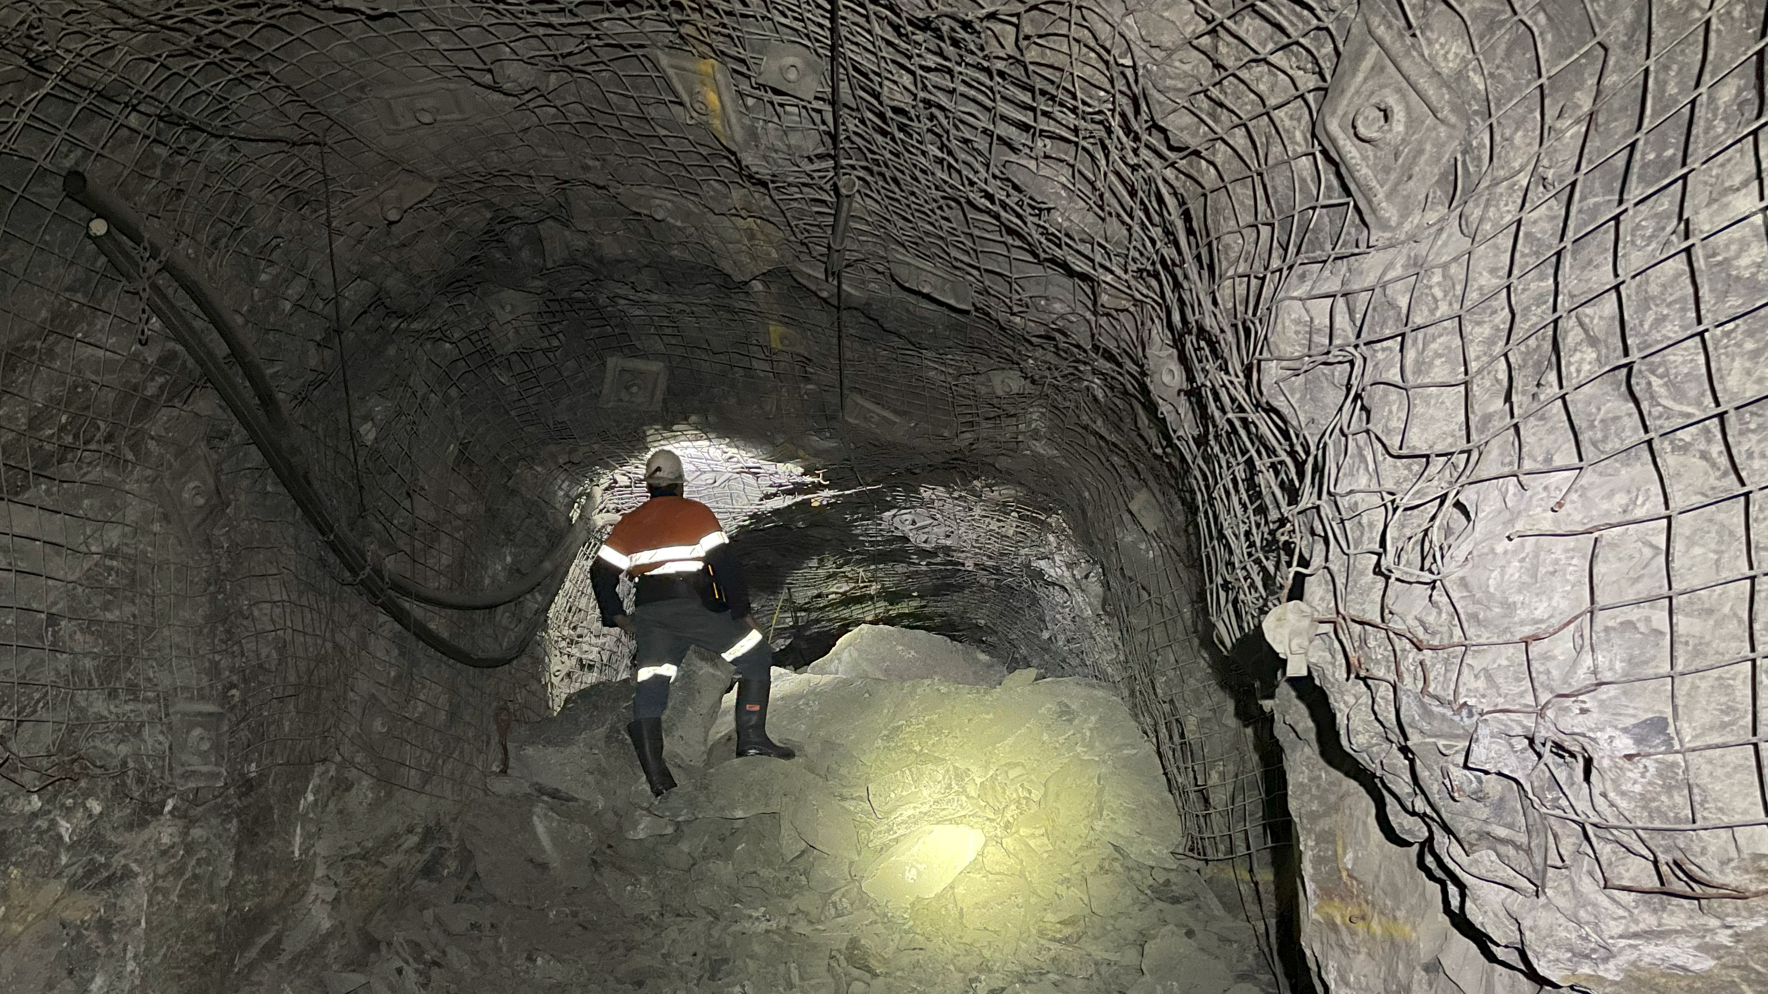
Thank you.
Any question?

